Slide 1


Team 63: Arbitrary Waveform Generator
Bi-Weekly Update 5 Leandro Bracho, Nick Joseph, Oscar Medrano, Robin Smithson Sponsor: Dr. John Lusher TA: Zhewen Hu
Notes:
Michelle

Slide 2
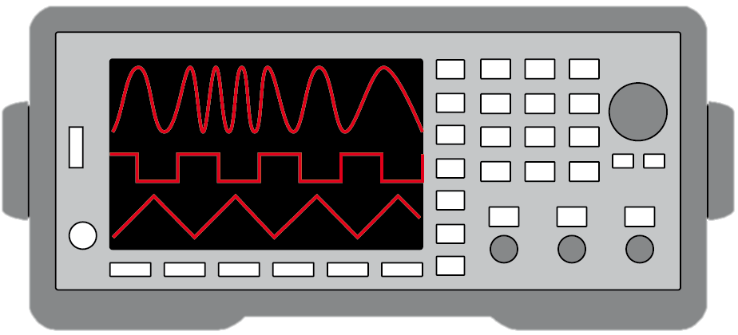
Project Summary
Problem Statement:
Test validation is a vital step in the design and fabrication of circuit boards for any project in the realm of electrical engineering.
Typical AWGs can be large and unintuitive
Solution Proposal:
Create a mobile user interface for the AWG
Bluetooth connection
Voltage range of +/- 10 V
Frequency between 1 Hz – 20 kHz
Maximum of 65,535 data points
Allow hand drawn waveforms
Notes:
Kyle

Slide 3
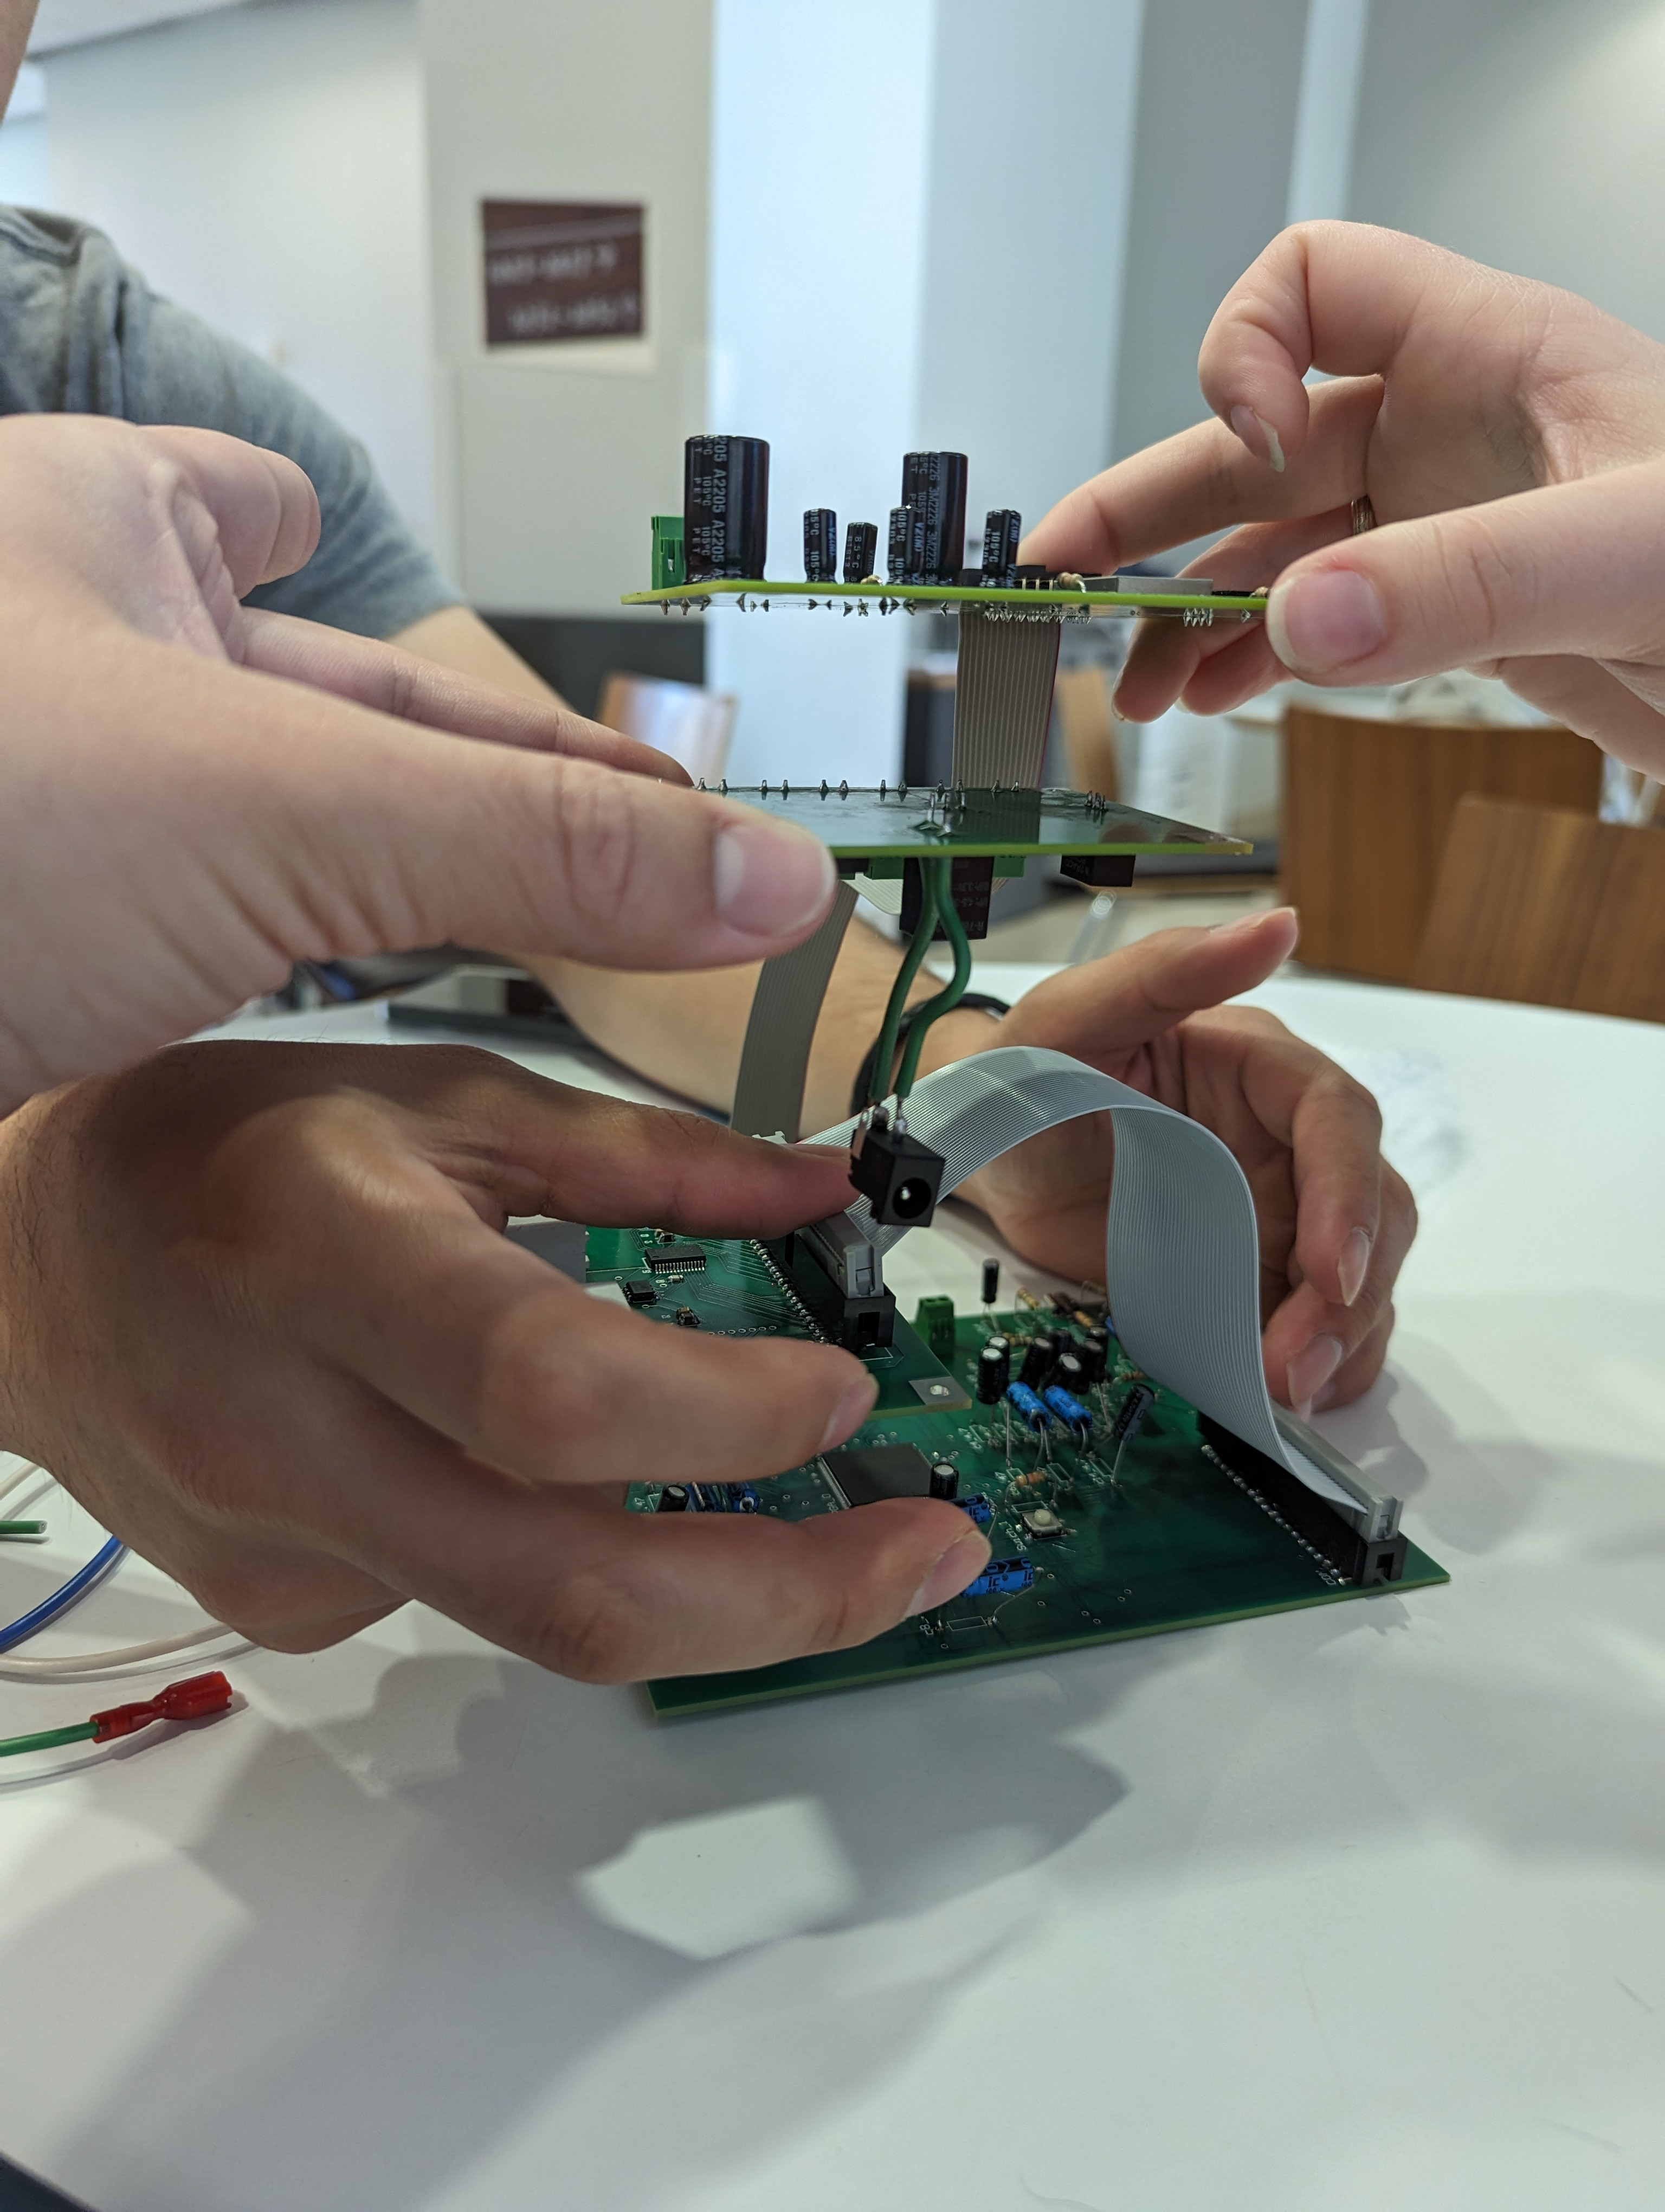
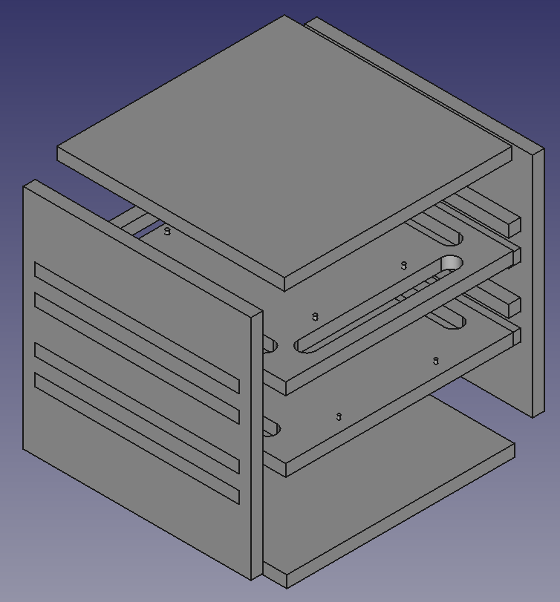
Integrated System Diagram
PCB Boards Stacked
CAD Model of Housing
Notes:
Eric

Slide 4
Project Timeline
Update PCBs from feedback from last semester (completed 1/29) | Revalidate & Assess Subsystems (completed 2/5) | Order New PCBs (completed by 2/16) | Integration of Bluetooth and Android App (completed 3/1) | Full Integration & System Test (to complete by 4/8) | Validation (to complete by 4/15) | Demo and Report (to complete by 4/29)
Notes:
Eric

Slide 5
Android Application
Accomplishments since last update 15 hrs of effort | Ongoing progress/problems and plans until the next presentation
Validated the user always knows the Bluetooth connection status. Tested if export, download, or Bluetooth buttons are pressed consecutively app performs operation once. Validated the app can be used entirely in Horizontal orientation Tested the progress bar during both export and download Validated the app can be used during write operations | Printing and assembling the housing
Notes:
For 5th review Accomplishments should include system testing and specific validation scenarios results:
“Validated correct system operation for temperatures from 25C to 50C”
“Completed battery lifetime system test for maximum workload and simple workload cases”
“Validated back end database loss and recovery”
“Tested image detection in flight Pi-4 on drone with detection accuracy of XX”
“Validated all app error handling for valve failures”
“ON-GOING 5 day field test of monitoring system”
“Developing validation scenarios for mobile user operating through App and dispatcher functions through web app interface”

Slide 6
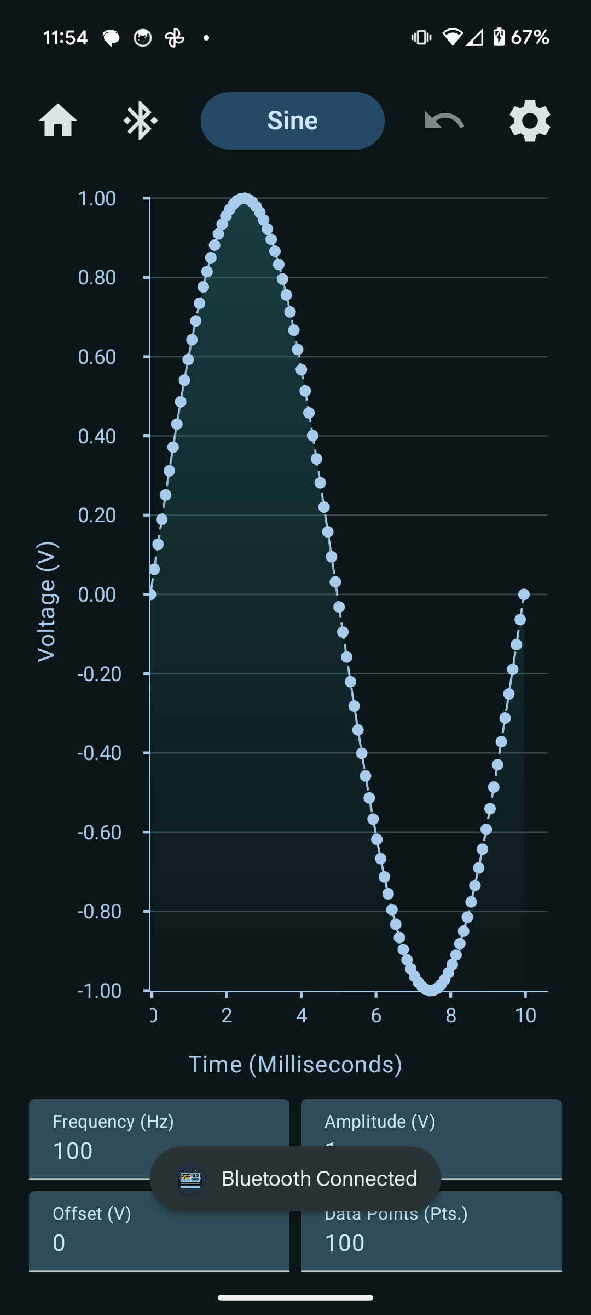
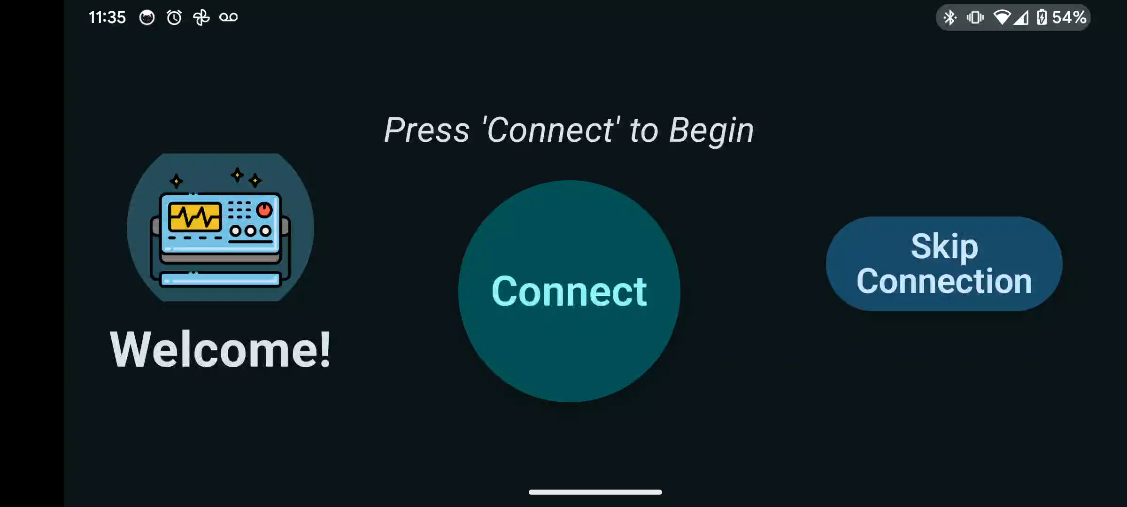
Android Application
Horizontal Orientation Video
Home Screen Connection
Notes:
This should all be test and validation results! – show things working, functional test results, error checking, etc, what validation is planned using what scenarios
Show test and validation results for integrated systems

Slide 7
MCU Robin Smithson
Accomplishments since last update 7 hrs of effort | Ongoing progress/problems and plans until the next presentation
Assisted with housing Assisted with app functionality testing Code ready to test with FPGA | Integrate with FPGA and Power System Assist with FPGA debugging Assist with housing

Slide 8
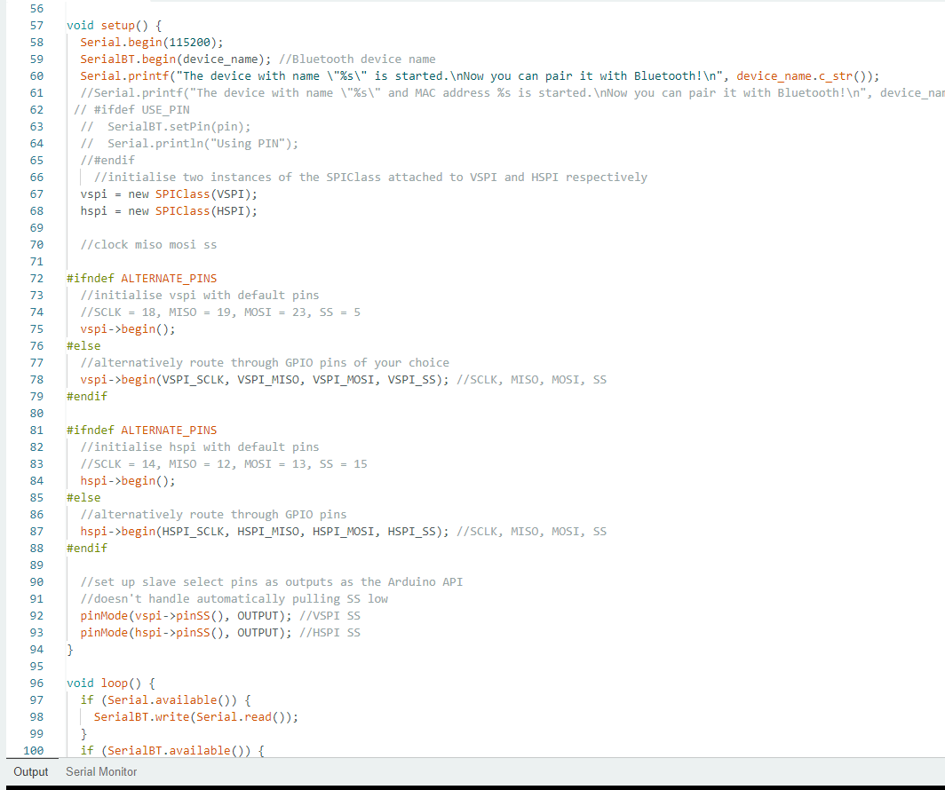
MCU Robin Smithson

Slide 9
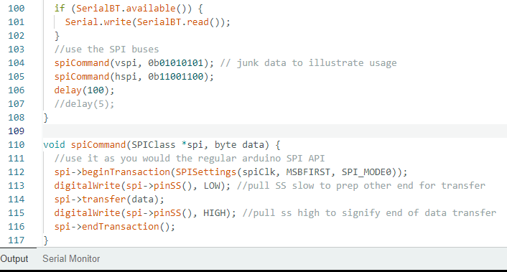
MCU Robin Smithson

Slide 10
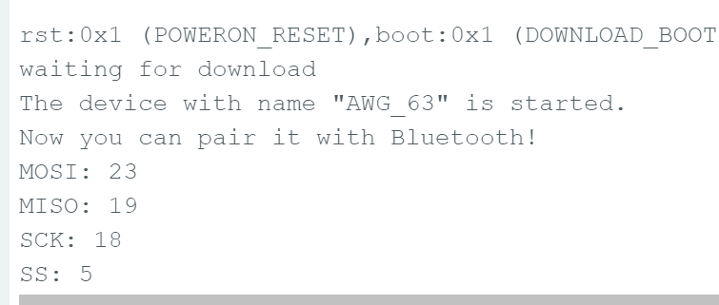
MCU Robin Smithson

Slide 11
FPGA
Accomplishments since last update 30 hrs of effort | Ongoing progress/problems and plans until the next presentation-
Board is running, the FPGA has been replaced. The USB plug is currently running but is a current sink when plugged in. | Fix the USB port Connect to MCU and start testing

Slide 12
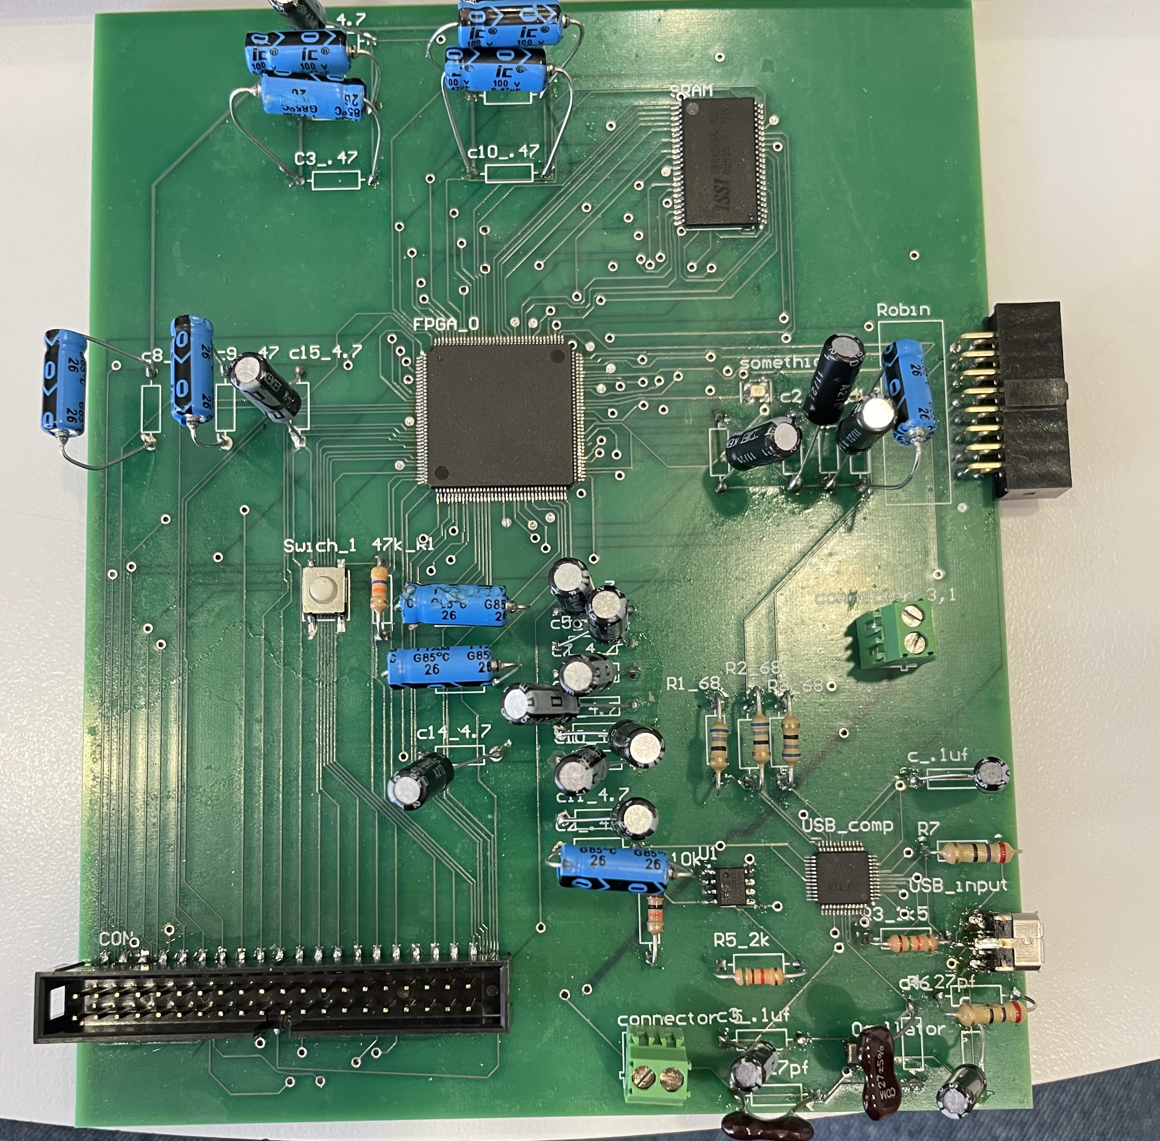
FPGA

Slide 13
DAC & Power System
Accomplishments since last update 8 hrs of effort | Ongoing progress/problems and plans until the next presentation
Jumped the power jack to the Power System. Completed tests on both the DAC and Power System. Power System is outputting the desired voltages. DAC has the desired output range. | Integrate the Power System with FPGA and MCU. Integrate the DAC with the FPGA Housing for the AWG.

Slide 14
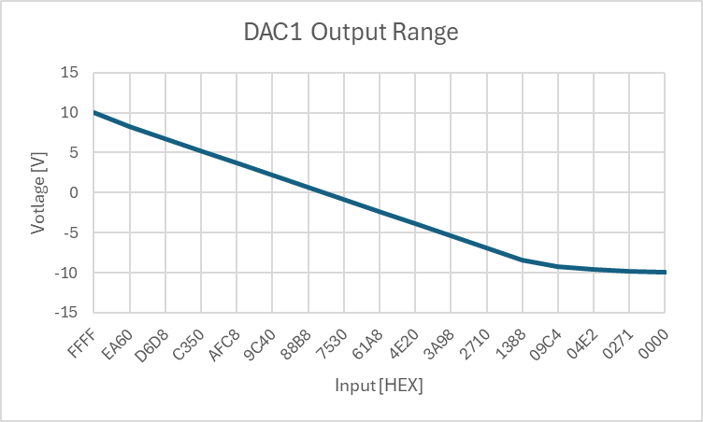
DAC System
DAC 1
Decimal | Hexadecimal | Voltage [V]
65535 | FFFF | 9.996
60000 | EA60 | 8.308
55000 | D6D8 | 6.782
50000 | C350 | 5.256
45000 | AFC8 | 3.731
40000 | 9C40 | 2.205
35000 | 88B8 | 0.68
30000 | 7530 | -0.845
25000 | 61A8 | -2.371
20000 | 4E20 | -3.896
15000 | 3A98 | -5.422
10000 | 2710 | -6.947
5000 | 1388 | -8.473
2500 | 09C4 | -9.236
1250 | 04E2 | -9.617
625 | 0271 | -9.808
0 | 0000 | -9.998

Slide 15
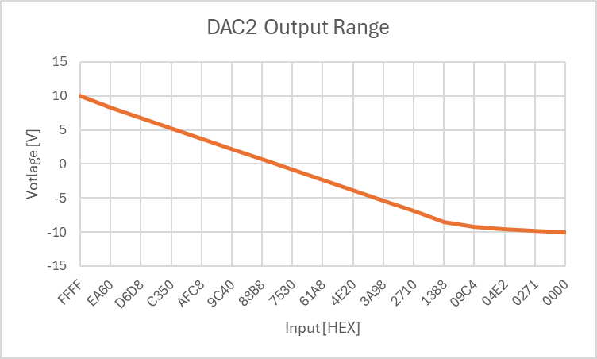
DAC System
DAC 2
Decimal | Hexadecimal | Voltage [V]
65535 | FFFF | 9.997
60000 | EA60 | 8.308
55000 | D6D8 | 6.782
50000 | C350 | 5.257
45000 | AFC8 | 3.731
40000 | 9C40 | 2.206
35000 | 88B8 | 0.68
30000 | 7530 | -0.845
25000 | 61A8 | -2.371
20000 | 4E20 | -3.896
15000 | 3A98 | -5.422
10000 | 2710 | -6.947
5000 | 1388 | -8.473
2500 | 09C4 | -9.236
1250 | 04E2 | -9.617
625 | 0271 | -9.808
0 | 0000 | -9.999

Slide 16
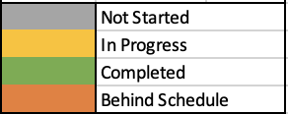
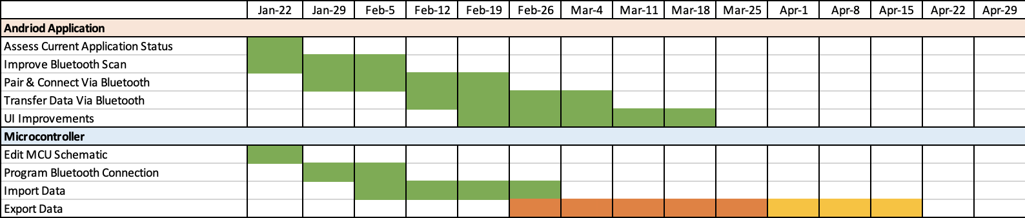
Execution Plan
Notes:
Michelle

Slide 17
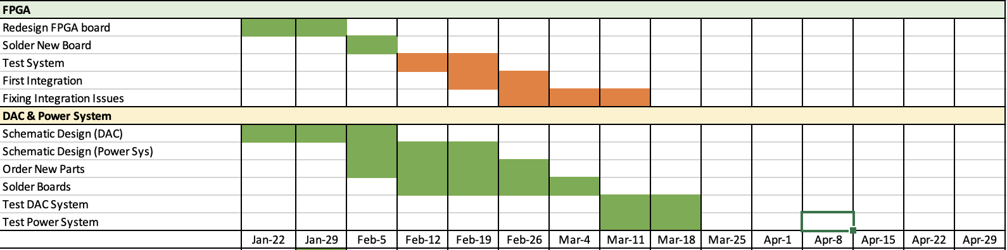
Execution Plan
Notes:
Michelle

Slide 18
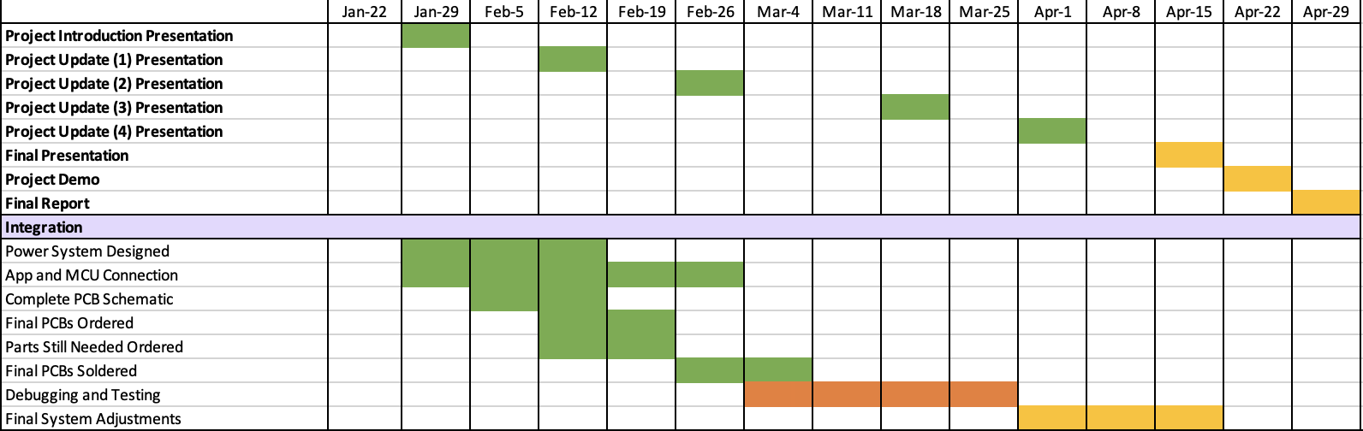
Execution Plan
Notes:
Michelle

Slide 19
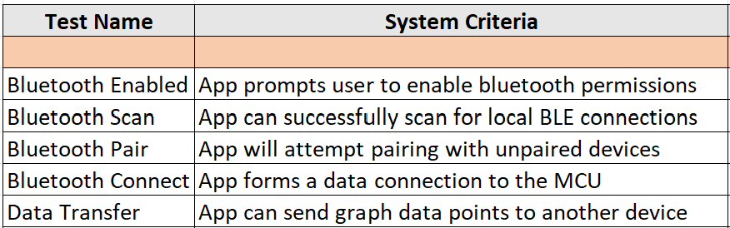
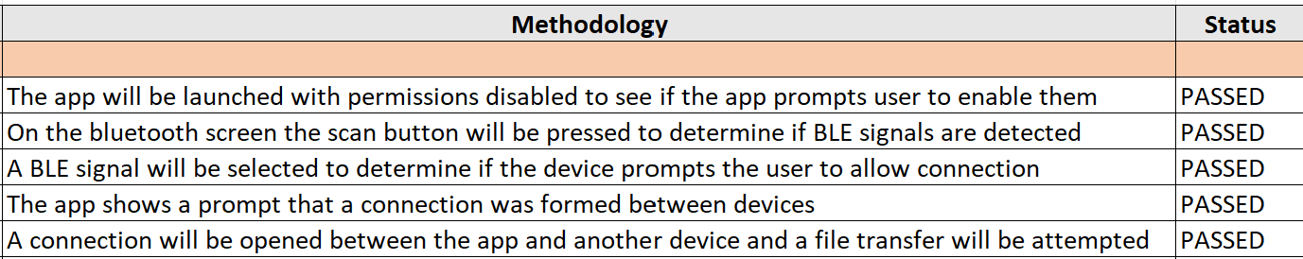
Android Application Validation Plan
Notes:
Michelle

Slide 20
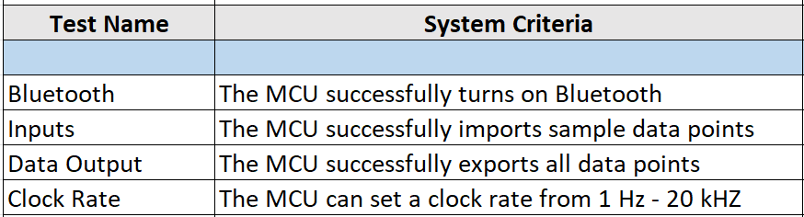
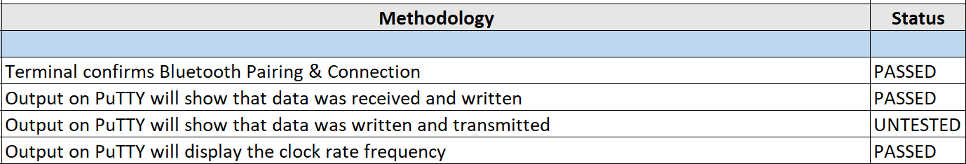
MCU Validation Plan
Notes:
Michelle

Slide 21
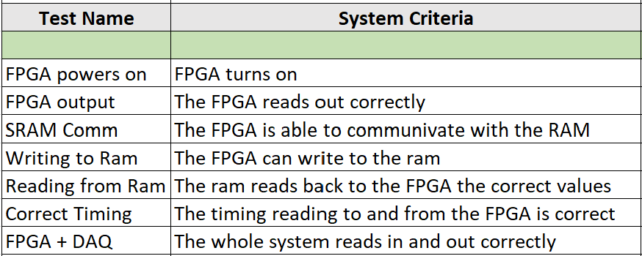
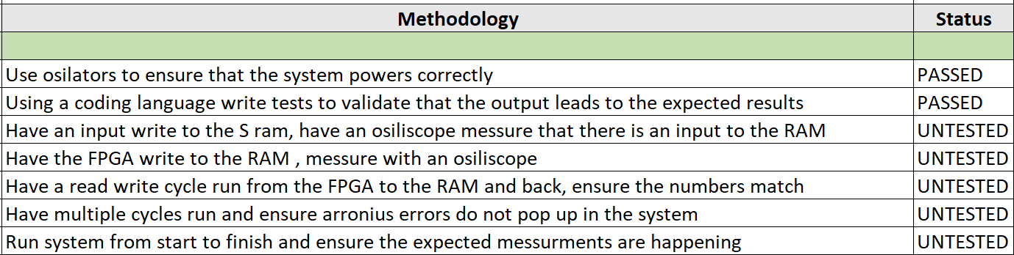
FGPA Validation Plan
Notes:
Michelle

Slide 22
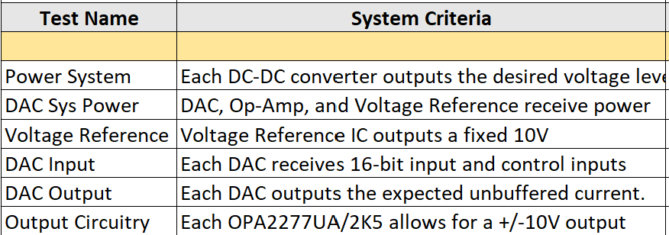
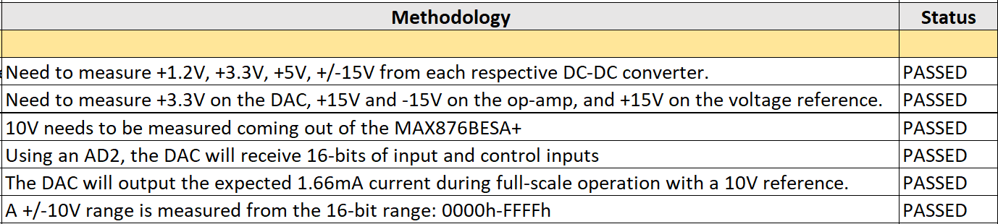
DAC & Power System Validation Plan
Notes:
Michelle

Slide 23
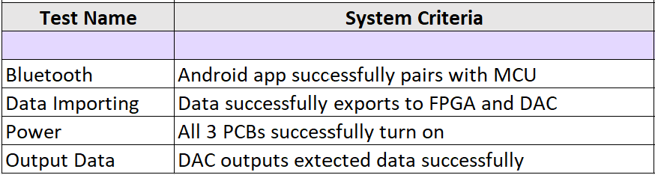
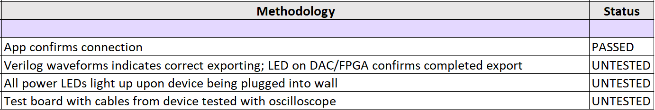
Integrated System Validation Plan
Notes:
Michelle

Slide 24
Thank you

